Slide 1

Charge Transport Simulation
Edited by Chun-I Wang
Last update: 2021.08.25
Also check Elderberry
/work/junyiwang/Charge_Transport_Simulation

Slide 2
OpenMM Resources
https://openmm.org/
http://docs.openmm.org/latest/userguide/
http://docs.openmm.org/latest/api-python/app.html
http://docs.openmm.org/latest/api-python/library.html
https://simtk.org/projects/openmm
https://simtk.org/api_docs/openmm/api5_0/python/index.html
https://github.com/openmm/openmm

Slide 3
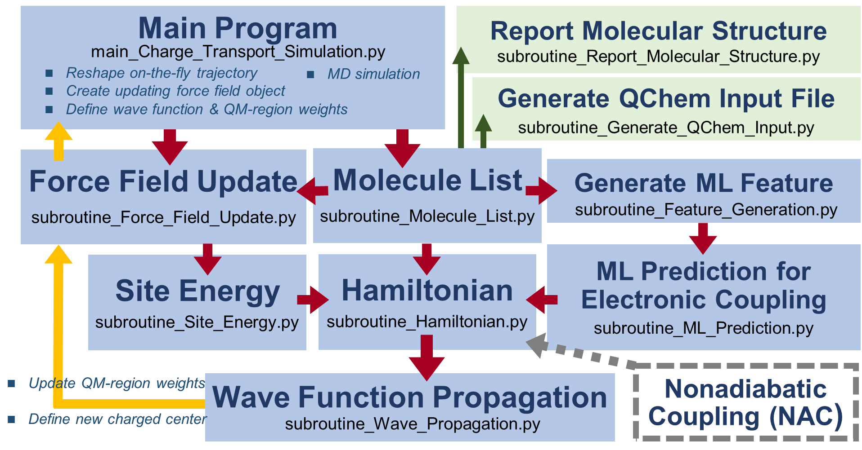
Primary steps
Before wave propagation
Extract structure for other APP
After wave propagation
Futrue update
Extract structure for other APP
Notes:
My ML work stems from the topic…

Slide 4
Overall Progress
0. Determine the initial charged center & update FF (only for t = 0 )
1. Reshape on-the-fly trajectory (OpenMM data format >>> NumPy array)
2. Update molecular list
3. ﻿Define Wave Function & Probability Density & QM-region weighting list
4. Calculate site energy (remove FF & recover FF)
5. Calculate electronic coupling
6. Build up Hamiltonian
7. Propagate wave packet
8. Update QM-region weighting list & force field list
9. Update charged state force field
10. ﻿Define the new charged center
11. Run MD simulation
12. For loop from step 1 to step 11

Slide 5
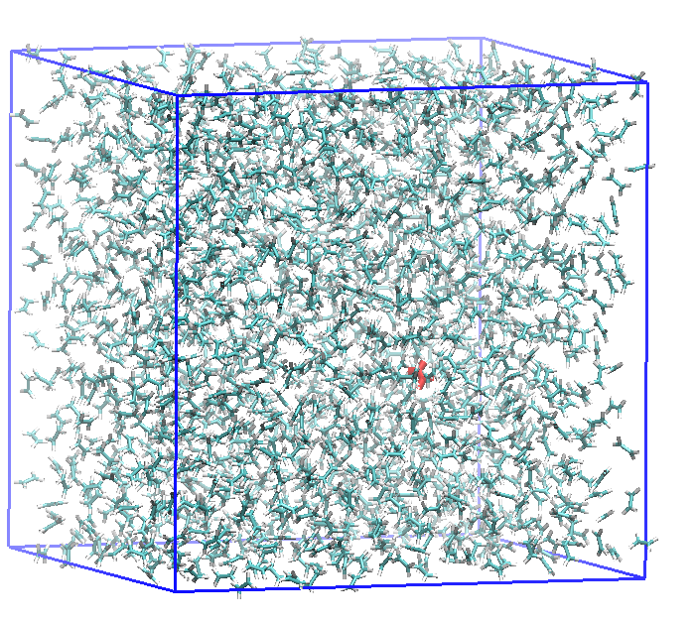
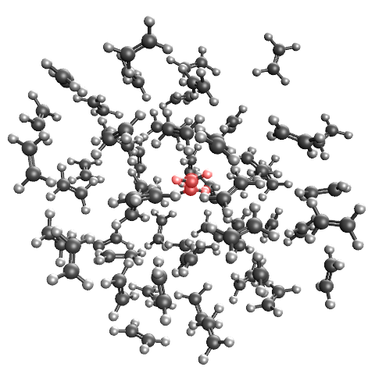
Overall Processing Flow
0. Determine the initial charged center & update FF (only for t = 0 )
1. Reshape on-the-fly trajectory
2. Update molecular list

Slide 6
Overall Processing Flow
3. ﻿Define wave function & probability density & QM-region weighting list
4. Calculate site energy (remove FF & recover FF)
5. Calculate electronic coupling
6. Build up Hamiltonian

Slide 7
Overall Processing Flow
7. Propagate wave packet

Slide 8
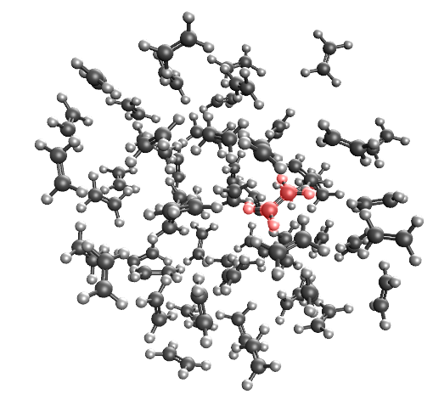
Overall Processing Flow
8. Update QM-region weighting list & force field list
9. Update charged state force field
10. ﻿Define the new charged center
11. Run MD simulation

Slide 9
Issue & Warning
The following warning message shows up when we implement zvode (Scipy ODE solver) for wave propagation.
UserWarning: zvode: Excess work done on this call. (Perhaps wrong MF.)
People discussed about this warning message
https://stackoverflow.com/questions/40788747/internal-working-of-scipy-integrate-ode
https://github.com/qutip/qutip/issues/822
https://docs.scipy.org/doc/scipy/reference/generated/scipy.integrate.ode.html
My trial: specify nsteps @ subroutine_Wave_Propagation
r = ode(dY_dt).set_integrator('zvode', method='bdf', nsteps=10000)

Slide 10
Main Program
Report Molecular Structure
main_Charge_Transport_Simulation.py
subroutine_Report_Molecular_Structure.py
Reshape on-the-fly trajectory
Create updating force field object
﻿Define wave function & QM-region weights
MD simulation
Generate QChem Input File
subroutine_Generate_QChem_Input.py
Force Field Update
Molecule List
Generate ML Feature
subroutine_Force_Field_Update.py
subroutine_Molecule_List.py
subroutine_Feature_Generation.py
ML Prediction for Electronic Coupling
Site Energy
Hamiltonian
subroutine_Site_Energy.py
subroutine_Hamiltonian.py
subroutine_ML_Prediction.py
Update QM-region weights
Define new charged center
Wave Function Propagation
Nonadiabatic Coupling (NAC)
subroutine_Wave_Propagation.py
Notes:
My ML work stems from the topic…

